Slide 1
FDTD Simulations with Meep

Slide 2
Meep
FDTD simulation software
Free and open-source
Distributed memory parallelism
Pre-compiled binary packages via conda
Inverse design tools
Python interface

Slide 3
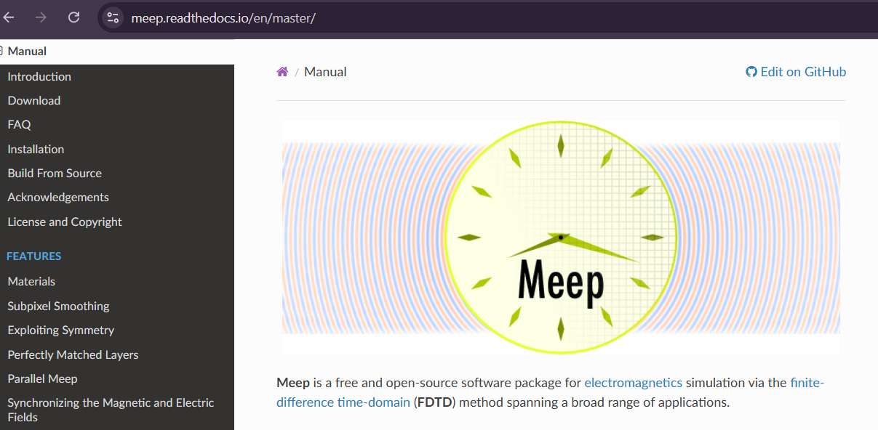
Check out the website
Documentation
Detailed explanations
Lots of tutorials

Slide 4
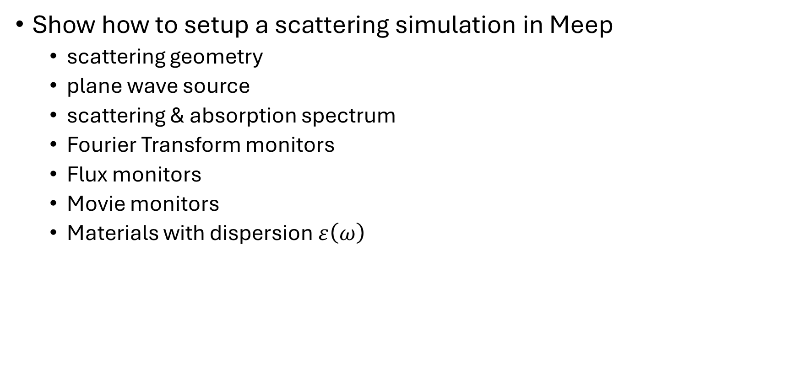
In this video
Show how to setup a scattering simulation in Meep
scattering geometry
plane wave source
scattering & absorption spectrum
Fourier Transform monitors
Flux monitors
Movie monitors
Materials with dispersion $ε\left(ω\right)$

Slide 5
Soon…
How to setup a waveguide simulation in Meep
Waveguide geometry
Mode source
Eigenmode expansion monitor
Inverse design with Meep
etc.

Slide 6
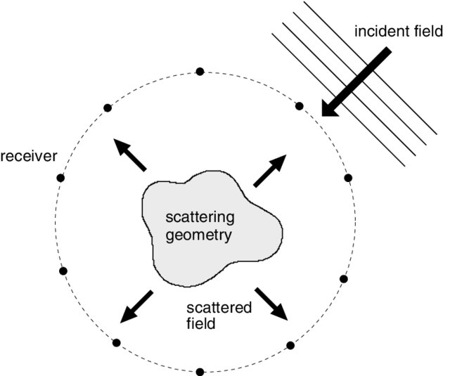
Scattering Problem
Plane wave incident on scatterer
Want to know:
How much light is scattered
How much light is absorbed
Erik Abenius, Time-Domain Inverse Electromagnetic Scattering using FDTD and Gradient-based Minimization (2004)

Slide 7
Scattering FDTD simulation
nanoparticle

Slide 8
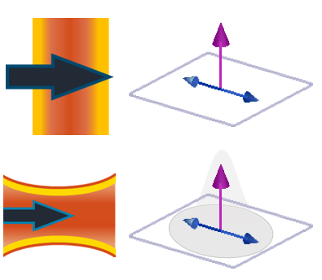
Scattering FDTD simulation
Total-field scattered-field source
nanoparticle

Slide 9
Scattering FDTD simulation
Total-field scattered-field source
nanoparticle

Slide 10
Scattering FDTD simulation
Scattering monitor
Total-field scattered-field source
nanoparticle

Slide 11
Scattering FDTD simulation
Absorbing Boundary Conditions
Scattering monitor
Total-field scattered-field source
Absorbing Boundary Conditions
nanoparticle
Absorbing Boundary Conditions
Absorbing Boundary Conditions

Slide 12
Scattering FDTD simulation
Absorbing Boundary Conditions
Scattering monitor
Total-field scattered-field source
Absorption monitor
Absorbing Boundary Conditions
nanoparticle
Absorbing Boundary Conditions
Absorbing Boundary Conditions

Slide 13

Scattering Meep FDTD simulation
Scattering geometry (nanoparticle)
Total-Field Scattered-Field (TFSF) source
Scattered box monitor (scattered field)
Absorption box monitor (total field)
Perfectly matched layer (PML) absorbing boundary conditions

Slide 14
Scattering Meep FDTD simulation
PMLs
Plane-wave source
Total-field box monitor
nanoparticle
PMLs

Slide 15
Scattering Meep FDTD simulation
PMLs
Plane-wave source
How do we isolate scattered light?
Total-field box monitor
nanoparticle
PMLs

Slide 16
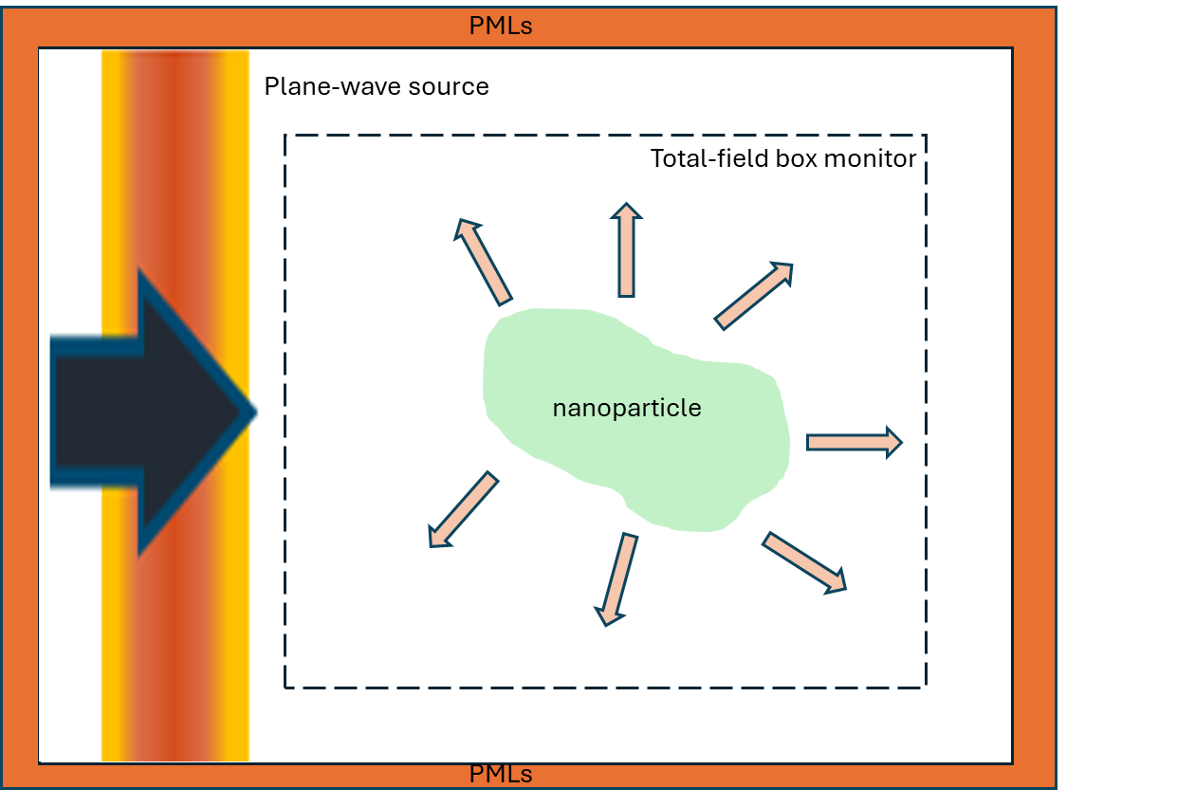
Scattering Meep FDTD simulation
$$E_{total}\left(r\right)=E_{source}\left(r\right)+E_{scattered}\left(r\right)$$

Slide 17
Scattering Meep FDTD simulation
$${E_{scattered}\left(r\right)=E}_{total}\left(r\right)−E_{source}\left(r\right)$$
We know this
We can find this

Slide 18
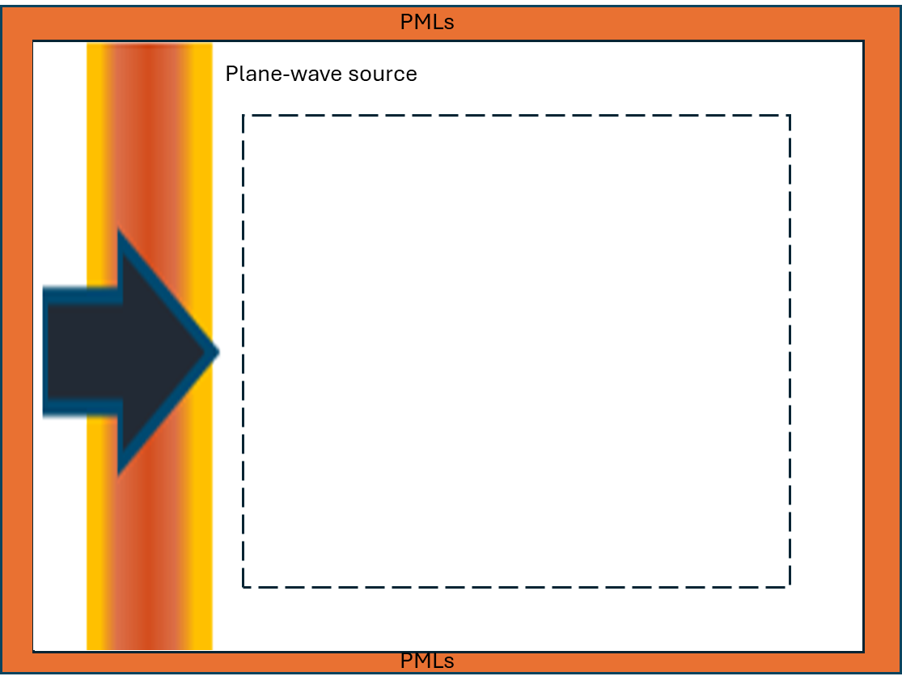
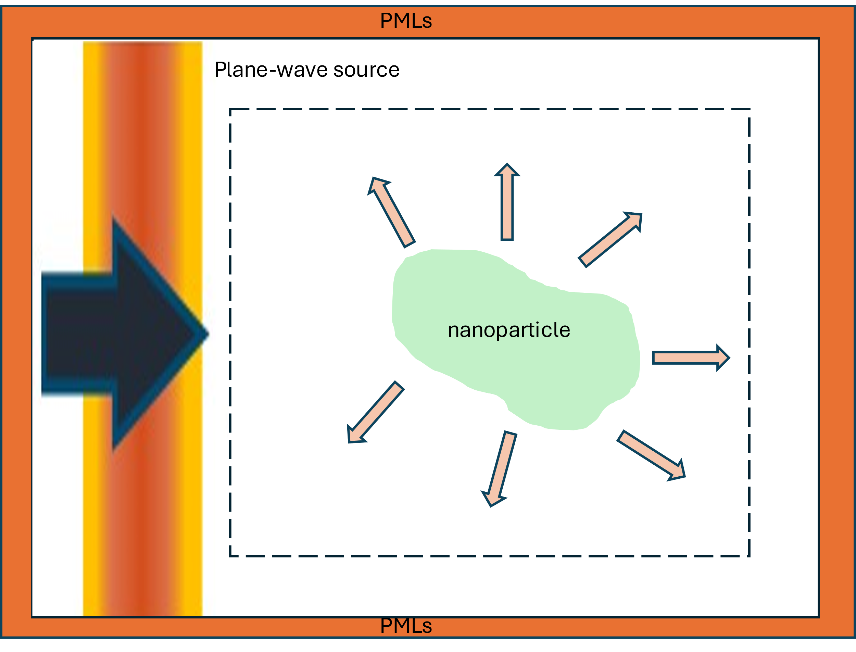


Scattering Meep FDTD simulation
Run 2 simulations!
Empty simulation - $E_{source}\left(r\right)$
Normal simulation - $E_{total}\left(r\right)$

Slide 19
Scattering Meep FDTD simulation
- We will be using flux monitors for scattering/absorption
flux monitors

Slide 20
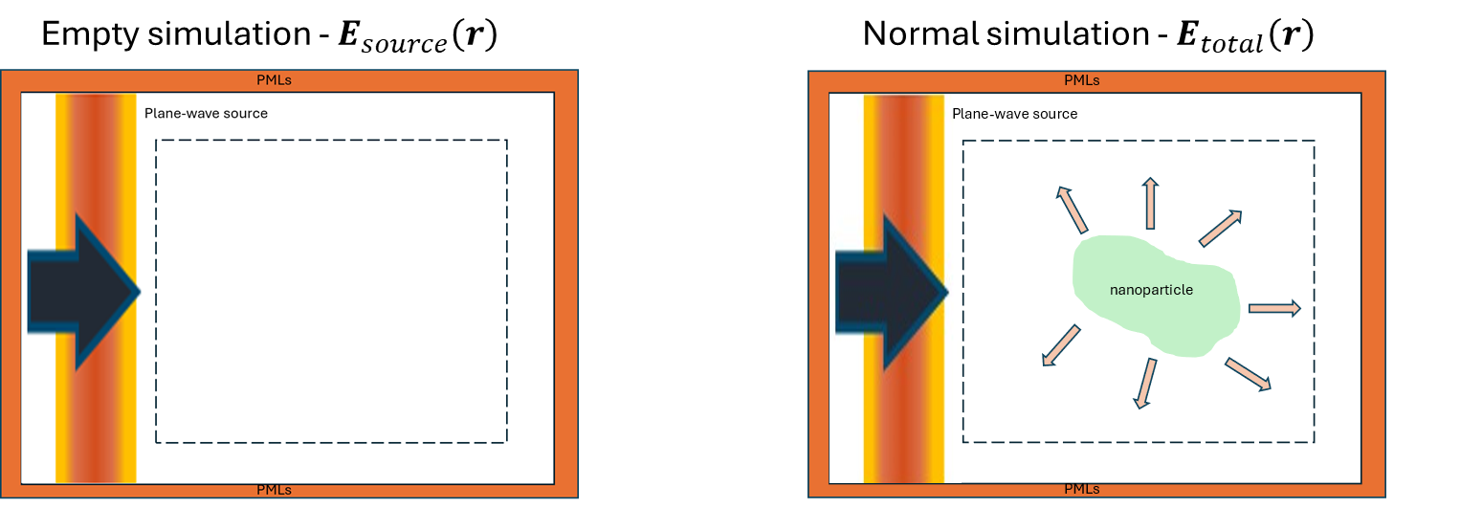

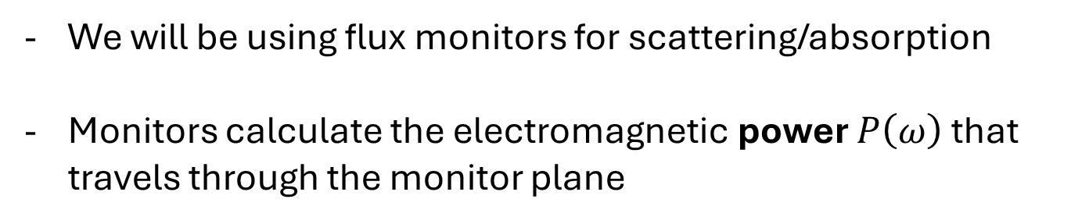



Scattering Meep FDTD simulation
We will be using flux monitors for scattering/absorption
Monitors calculate the electromagnetic power $P\left(ω\right)$ that travels through the monitor plane
$P_{+y}\left(ω\right)$
$P_{−x}\left(ω\right)$
$P_{+x}\left(ω\right)$
$P_{−y}\left(ω\right)$

Slide 21

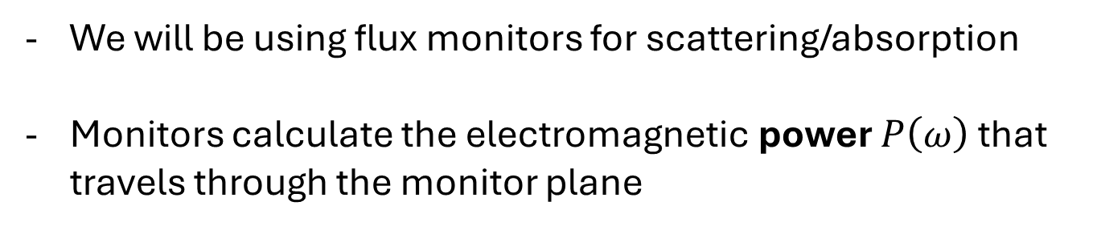
Scattering Meep FDTD simulation
We will be using flux monitors for scattering/absorption
Monitors calculate the electromagnetic power $P\left(ω\right)$ that travels through the monitor plane
$$P_{+x}\left(ω\right)=\iint{dy dz S_{x}\left(ω,y,z\right)}$$
Flux monitor
Power travelling through y-z Flux monitor
(in the x-direction)
Integral of x-component of Poynting vector integrated over the montor surface

Slide 22

Scattering Meep FDTD simulation
We will be using flux monitors for scattering/absorption
Monitors calculate the electromagnetic power $P\left(ω\right)$ that travels through the monitor plane
$$P_{−x}\left(ω\right)=−\iint{dy dz S_{x}\left(ω,y,z\right)}$$
Flux monitor
Power travelling through y-z Flux monitor
(in the minus x-direction)
Integral of x-component of Poynting vector integrated over the montor surface

Slide 23
Scattering Meep FDTD simulation
We will be using flux monitors for scattering/absorption
Monitors calculate the electromagnetic power $P\left(ω\right)$ that travels through the monitor plane
$${E_{scattered}\left(r\right)=E}_{total}\left(r\right)−E_{source}\left(r\right)$$
$$P_{scattered}≠P_{total}−P_{source}$$

Slide 24
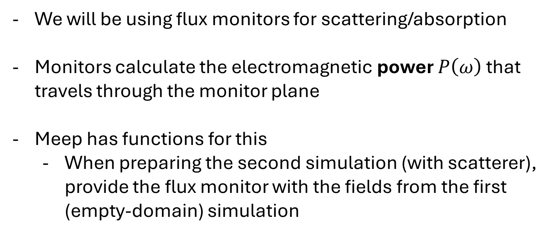
Scattering Meep FDTD simulation
We will be using flux monitors for scattering/absorption
Monitors calculate the electromagnetic power $P\left(ω\right)$ that travels through the monitor plane
Meep has functions for this
When preparing the second simulation (with scatterer), provide the flux monitor with the fields from the first (empty-domain) simulation
data from empty simulation
monitor for scattering simulation

Slide 25
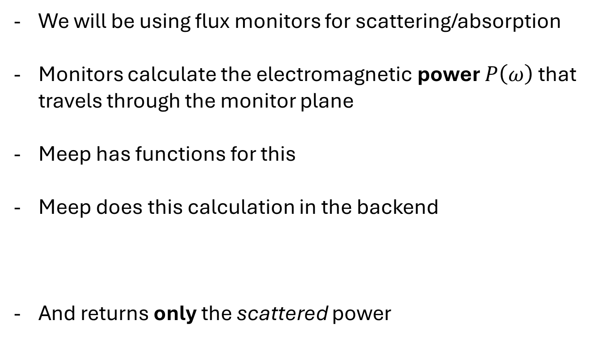
Scattering Meep FDTD simulation
We will be using flux monitors for scattering/absorption
Monitors calculate the electromagnetic power $P\left(ω\right)$ that travels through the monitor plane
Meep has functions for this
Meep does this calculation in the backend
And returns only the scattered power
$${E_{scattered}\left(r\right)=E}_{total}\left(r\right)−E_{source}\left(r\right)$$

Slide 26

Scattering Summary
Run 2 simulations: 1) just to calculate $E_{source}$ and 2) for $E_{total}$

Slide 27





Scattering Summary
Run 2 simulations: 1) just to calculate $E_{source}$ and 2) $E_{total}$
Use Meep tools to get scattered power $P\left(ω\right)$ for each Flux monitor
$P_{+y}\left(ω\right)$
$P_{−x}\left(ω\right)$
$P_{+x}\left(ω\right)$
$P_{−y}\left(ω\right)$

Slide 28
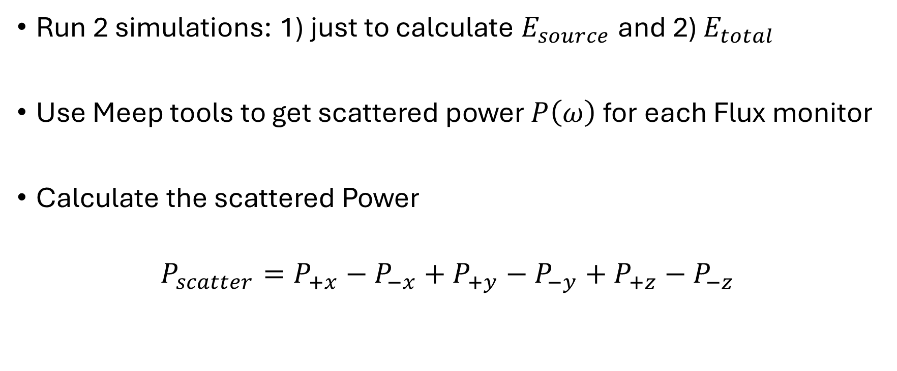
Summary
Run 2 simulations: 1) just to calculate $E_{source}$ and 2) $E_{total}$
Use Meep tools to get scattered power $P\left(ω\right)$ for each Flux monitor
Calculate the scattered Power
$$P_{scatter}=P_{+x}−P_{−x}+P_{+y}−P_{−y}+P_{+z}−P_{−z}$$

Slide 29
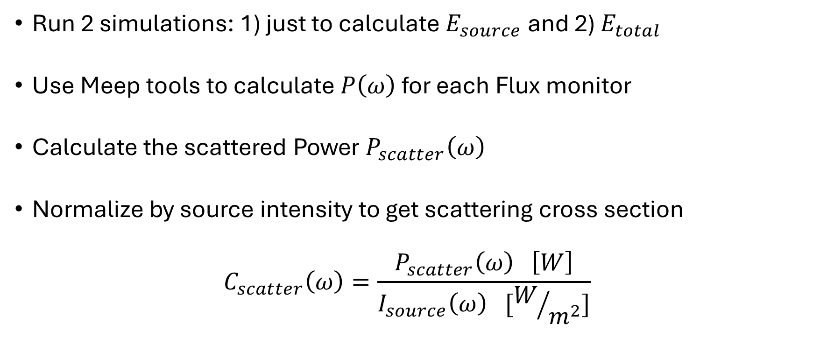
Summary
Run 2 simulations: 1) just to calculate $E_{source}$ and 2) $E_{total}$
Use Meep tools to calculate $P\left(ω\right)$ for each Flux monitor
Calculate the scattered Power $P_{scatter}\left(ω\right)$
Normalize by source intensity to get scattering cross section
$$C_{scatter}\left(ω\right)=\frac{P_{scatter}\left(ω\right) \left[W\right]}{I_{source}\left(ω\right) [W/{m^{2}}]}$$

Slide 30
Absorption
Same thing, but using only the total-field fluxes

Slide 31

Practical notes
Meep uses special units
Speed of light $c_{0}=1$

Slide 32

Practical notes
Meep uses special units
Speed of light $c_{0}=1$
Length-distances are in microns
Frequencies are $1/wavelength$
Wavelength in microns

Slide 33

Practical notes
Meep uses special units
Speed of light $c_{0}=1$
Length-distances are in microns
Frequencies are $1/wavelength$
Wavelength in microns

Slide 34
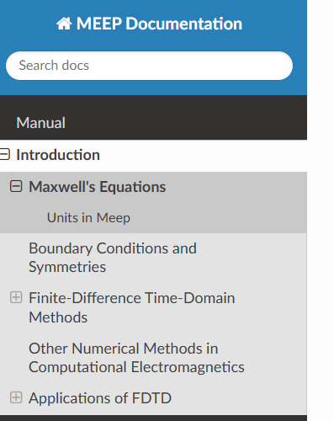

Slide 35

Practical notes
Meep uses special units
The simulation domain is centered at 0
If the simulation domain is $S_{x}×S_{y}×S_{z}→\left(−\frac{S_{x}}{2},\frac{S_{x}}{2}\right),\left(−\frac{S_{y}}{2},\frac{S_{y}}{2}\right)$ $,\left(−\frac{S_{z}}{2},\frac{S_{z}}{2}\right)$

Slide 36


Size_x
PML
Size_y
$$y=0$$
Plane wave source
PML
$$x=0$$

Slide 37
Code break!

Slide 38
